Slide 1
Surgery of the Vermiform Appendix & acute abdomen
By
Dr. Hosam Elsrogy
Prf. of General Surgery
Sohag University
2018

Slide 2
Items
Introduction
Surgical anatomy
Inflammations of appendix
acute
chronic
recurrent
Tumours of appendix
Carcinoid (argentaffinoma)
1ry adenocarcinoma
Causes of acute abdomen

Slide 3
Introduction
Appendix is a vestigial organ.
Surgical importance-------inflammations------clinical syndrome of acute appendicitis (AA).
AA is the most common cause of acute abdomen in young adults.
Appedecectomy (appendectomy) is the frequently performed urgent abdominal op.
Diagnosis of AA is essentially clinical.

Slide 4
Surgical anatomy
Vermiform appendix is present only in human & certain anthropoid apes.
Blind muscular tube at distal end of caecum.
4 layers--------- mucosa, submucosa, musculosa & serosa.
At birth, it is short & broad at its junction with caecum.
By age of 2 ys------ typical tubular structure (due to differential growth of the caecum)

Slide 5
Surgical anatomy; positions of appendix
Retrocaecal -------- 74%
Pelvic -------- 21%
Postileal -------- 5%
Paracaecal -------- 2%
Subcaecal -------- 1.5%
Preileal --------- 1% (typical C/P)
Subhepatic --------- very rare
Lt. sided --------- situs inversus viscerum

Slide 6
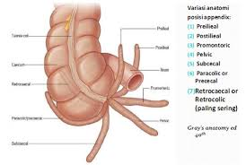

Slide 7
Surgical anatomy (cont.)
Position of base of the appendix is constant -------- at the confluence of the 3 tinea coli.
Mesoappendix arises from lower surface of mesentery of terminal ileum.
Bl. Supply -------- appendicular a. (from lower division of ileocolic a.), it is an end a.----- thrombosis ----- gangrenous appendicitis.
Accessory appendicular a. in most people.
Lymph drainage ----- 4-6 lymph channels ---- ileocaecal LNs

Slide 8
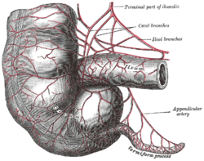
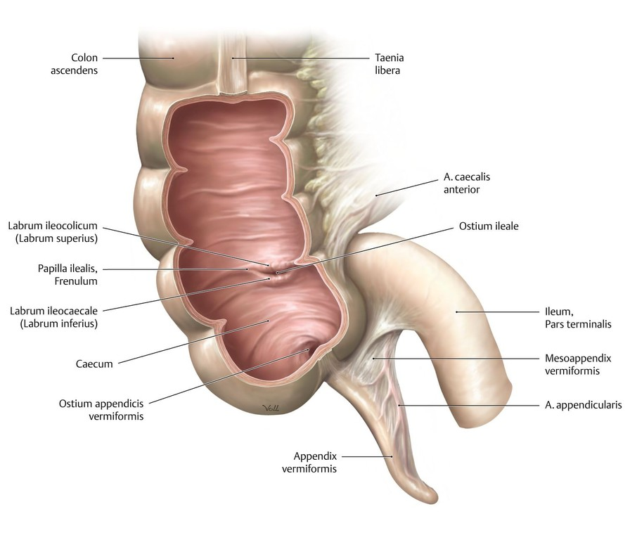

Slide 9
Microscopic anatomy
Length ------- 7.5-10 cm
Irregular lumen, multiple folds of m.m lined by col. cell intestinal mucosa of colonic type.
Crypts are present but not numerous----- at base of crypts ------ Argentaffin Cs (Kultschitzsky Cs) ------- carcinoid tumour.
App. is the most frequent site for carcinoid ts.
Submucosa ------ lymphatic aggregations or follicles especially in young adults ----- AA.

Slide 10
Acute appendicitis - Incidence
One person in 6-7 develops AA at some time.
Age:
rare in infants
Common in childhood & early adult life
Peak incidence → teens & early 20s
↓ ↓ after middle age
Sex:
Equal before puberty
More in males at teenagers & young adults (3:2)
After that age → equal

Slide 11
AA- Incidence (cont.)
AA is the commonest abdominal surgical emergency.
AA is a disease of civilisation.
Relatively uncommon in developing rural communities.
Incidence ↑ in developing countries adopting a more-refined western-type diet

Slide 12
AA- Surgical pathology
Aetiology & predisposing factors:
Infective agents
Obstructive agents
Infective agents:
Bacterial proliferation within the appendix
Mixed intestestinal organisms (aerobic & anaerobic) e.g., coliforms, entercocci, bacteroides & others.
Infection either:
1ry → lymphoid hyperplasia.
2ry → bacteria → wall of appendix through epithelial erosion caused by pressure of an obstructing agent.

Slide 13
AA- Surgical pathology (cont.)
Obstructing agents:
Faecolith (inspissated faecal material, Ca phosphates, bacteria, epithelial debris)
F.B. (vegetable seeds, date stones)
Fibrotic stricture (previous resolved AA)
Tumour (caecal Ca in older ages, carcinoid)
Intestinal parasites (thread; round & pinworms)
Lymphoid hyperplasia in submucosa ; viral causes

Slide 14
AA- Surgical pathology (cont.)
Clinicopathological types of AA:
Acute appendicitis
Acute appendicitis with inflammatory mass
Acute appendicitis with generalised peritonitis
Mucocele of the appendix

Slide 15
AA- Surgical pathology (cont.)
Early AA → mucosal inflam. & lymphoid hyperplasia with patent lumen.
If obstruction occurs → cont. mucous sec. + inflam. exudate (pus) → ↑ intraluminal pr. → obstruct lymphatic drainage → oedema & mucosal ulceration → bact. translocation into submucosa.
Fate: either
Resolution (spontaneous or Antibiotic)
Progress

Slide 16
AA- Surgical pathology (cont.)
Progression → further distension→ venous obstruction → ischaemia of app. wall → bacterial invasion through muscularis propria & submucosa → AA (red, turgid appendix).
Finally ischaemic necrosis → gangrenous app.
Common close to the tip of appendix due to ↓ blood supply or
At the site of obstruction due to pressure necrosis

Slide 17
AA- Surgical pathology (cont.)
Fate of gangrenous appendicitis:
Free bacterial contamination in peritoneal cavity →generalised peritonitis → intense peritoneal reaction with fluid outpouring → initially clear, late purulent → serosal surface of bowel is injected & flaked with clotted lymph.
Rapid localisation by defence mechanism (greater omentum & coils of small bowel) → phlegmonous mass or paracaecal abscess if suppuration occurs.
Rarely, resolution of app inflam → distended mucous-filled app → mucocele of the appendix.
Notes:
→

Slide 18
AA with generalised peritonitis
It is the great threat of acute appendicitis
Causes of peritonitis:
Free migration of bacteria through ischaemic appendicular wall
Frank perforation of gangrenous appendix
Delayed perforation of appendicular abscess

Slide 19
Risk factors for perforation of appendix
Extreme of age (ill-developed omentum)
Immunosuppression
Diabetes mellitus
Faecolith obstruction
Pelvic appendix (lying free in pelvis; 21%)
Previous abdominal surgery
pregnancy

Slide 20
AA- Clinical features
Periumbilical colic (poorly localised, visceral)
Pain shifts to RIF (intense, constant & localised somatic pain due to parietal peritoneal irritation)
Anorexia (constant especially in children)
Nausea
Vomiting (1 or 2 episodes after onset of pain)
History of previous similar discomfort which setteled spontaneously

Slide 21
AA- Clinical features (cont.)
Typical features are present in 50%.
Atypical features→ poorly localised somatic or visceral pain especially in:
Elderly → no RIF pain
Pelvic appendicitis
→ no somatic pain in ant. abd. wall
→ suprapubic discomfort & tenesmus
→ tenderness on PR examination

Slide 22
AA- Clinical features (cont.)
Typically 2 clinical syndromes of AA:
Acute catarrhal (non obstructive) appendicitis
Acute obstructive appendicitis
→ acute course
→ abrupt onset
→ generalised abdominal pain from start
→ temp. may be normal & vomiting is common
→ mimic acute intestinal obstruction

Slide 23
AA- Signs
General
Local
Special
General signs:
Look → unwell, coated tongue & foul breath
Pyrexia → low grade (37.2-37.7˚C)
→ absent in 20% of cases
→ In children if > 38.5˚C → other cause e.g., mesenteric adenitis
Tackycardia → 80-90 beats/ min, absent in 20%

Slide 24
AA- Signs
Local signs:
Localised tenderness in RIF;McBurney’s point
Muscle guarding over RIF
Rebound tenderness(coughing or percussion)
Limitation of resp. movement in lower abd.
Pointing sign
Tender PR exam on Rt side in pelvic app.
Cutaneous hyperaesthesia in RIF

Slide 25
AA- Signs
Special signs:
Rovsing’s sign (on deep pressure on LIF)
Blumberg’s sign (crossed or rebound tenderness on sudden release of deep pressure on LIF)
Psoas sign (pain on extension of Rt. hip)
Obturator (Cope’s) sign (pain on flexion & internal rotation of Rt. Hip in pelvic app.)
Straight leg raising sign

Slide 26
AA- Special features
Retrocaecal appendix:
Absent rigidity
Lack localised deep tendern. at RIF (silent app)
Deep tenderness at loin
Rigidity of quadratus lumborum
+ve psoas spasm

Slide 27
AA- Special features
Pelvic appendix:
Early diarrhoea
Complete absence of abdominal rigidity
Lack of tenderness at McBurney’s point
Deep tendern. above & to Rt. of symphysis pubis
Tendern. in retrovesical or Douglas pouch on PR
Psoas spasm & obturator internus muscles
Frequency of micturition

Slide 28
AA- Special features
Postileal appendix:
Pain may not shift (missed appendix)
Diarrhoea is present
Ill-defined tenderness or may be present immediately to the Rt. of the umbilicus

Slide 29
AA- Special features
Appendicitis in infants & young children:
Rare under 36 months of age
Often delayed diagnosis:
Patient unable to give history
High incidence of perforation
Diffuse peritonitis develop rapidly due to ill-developed omentum

Slide 30
AA- Special features
Appendicitis in older children:
Vomiting is always
Complete aversion to food
No sleep during attack
Absent bowel sounds in early stages
Appendicitis in elderly:
High incidence of gangrene & perforation
Little signs due to lax abdominal walls or obesity
May simulate subacute intestinal obstruction
Higher mortality rates

Slide 31
AA- Special features
AA in obese patients:
↓ all local signs with delay in diagnosis
Technically difficult operation
Consider a midline abdominal incision
AA in pregnancy:
AA is the most common extrauterine abd condition
Frequency is one in 1500-2000 pregnancies
Delay in presentation & early nonspecific symptoms
High appendix late in pregnancy → flank or back pain confused with pyelonephritis
Foetal loss occurs in 3-5% & 35% if perforation occurs

Slide 32
D.D. of acute appendicitis & acute abdomen
Children:
Acute gastroenteritis
Mesenteric lymphadenitis
Meckel’s diverticulitis
Intussusception
Henoch-Schönlein purpura
Lobar pneumonia & pleurisy

Slide 33
D.D. of acute appendicitis & acute abdomen
Adults:
Regional enteritis (Crohn’s disease)
Ureteric colic
Perforated ulcer
Torsion testis
Pancreatitis
Rectus sheath haematoma

Slide 34
D.D. of acute appendicitis & acute abdomen
Adult females:
Salpingitis
Mittelschmerz
torsion/rupture of an ovarian cyst
Ectopic pregnsncy
Pyelonephritis
Endometriosis

Slide 35
D.D. of acute appendicitis & acute abdomen
Elderly:
Sigmoid diverticulitis
Intestinal obstruction
Colonic carcinoma
Torsion appendix epiploicae
Mesenteric infarction
Aortic aneurysm

Slide 36
D.D. of acute appendicitis & acute abdomen
Rare D.D.:
Preherpetic pain of Rt 10th&11th dorsal nerves
Tabetic crises
Spinal conditions
Porphyria & D.M.
Cyclical vomiting of infants or young children
Typhlitis or leukaemic ileocaecal syndrome

Slide 37
preoperative investigations in AA
Routine:
Full blood count
urinlysis
Selected cases:
Pregnancy test
Urea & electrolytes
Supine AXR
Ultrasound abdomen/pelvis

Slide 38
Ttt of acute AA
appendicectomy:
Conventional
McBurney’s incision
Lanz incision
Lower midline abdominal incision
Rutherford Morrison’s incision
Retrograde appendectomy
Drainage of peritoneal cavity
laparoscopic

Slide 39
Problems encountered during appendicectomy
A normal appendix:
Careful exclusion of other possible diagnosis esp Crohn’s disease, Meckel’s diverticulitis, tubal or ovarian causes
Remove appendix
The appendix cannot be found:
Mobilise the caecum& trace tinea coli
Absent appendix
An appendix abscess is found & appendix could not removed easily:
Local peritoneal toilet & drainage of abscess
I.v antibiotics
Very rarely. Caecectomy or partial Rt hemicolectomy

Slide 40
AA complicating Crohn’s disease
If caecal wall is healthy at base of appendix→ appendicectomy.
If appendix is involved in CD→ conservative approach→ I.V corticosteroids & ststemic AB

Slide 41
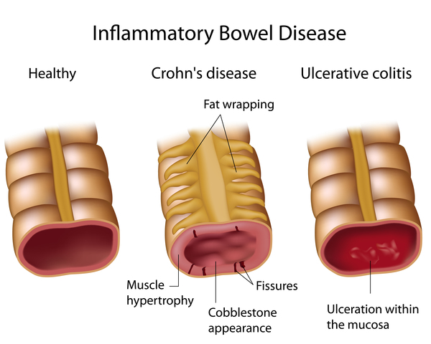
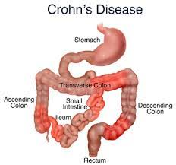

Slide 42
Abscesses complicating AA
Appendix abscess
Pus within the phlegmonous appendix mass
Failure of resolution of appendix mass
Continued spiking pyrexia
Percutaneous drainage under US or CT guide
Laparotomy through a midline incision
Extraperitoneal drainage
Pelvic abscess
Spiking pyrexia several days after appendicitis or discharge
Pelvic discomfort, loose stool or tenesmus
PR→ boggy mass in pelvis, ant. to rectum
Pelvic US or CT
Transrectal drainage

Slide 43
Ttt of appendix mass
The standard conservative Ochsner-Sherren regimen
Careful record of patient’s condition
Regular exam of abdomen
Mark limits of the mass on the abdominal wall
Nasogastric tube
Intravenous fluids
Systemic antibiotic therapy
Record temp & pulse every 4 hrs
Clinical improvement within 24-48 hrs
Remove appendix usually after an interval of 6-8 weeks

Slide 44
Criteria for stopping conservative ttt of appendix mass
A rising pulse rate
Increasing or spreading abdominal pain
Increasing size of the mass
Vomiting or copious gastric aspirate

Slide 45
Neoplasms of appendix
Carcinoid tumour (argentaffinoma)
Arise in argentaffin tissue (Kulschitzsky Cs of crypts of Lieberkuhn)
Most commonly found in appendix
Found once in every 300-400 appendices
10 times more common than any other neoplasms
Subacute or recurrent appendicitis
Frequently involves distal third of appendox
Rarely gives rise to metastases
Small tumours < 2 cm→ appendicectomy
Rt hemicolectomy if involved caecal wall, tumour is 2 cm or more or involved LN

Slide 46
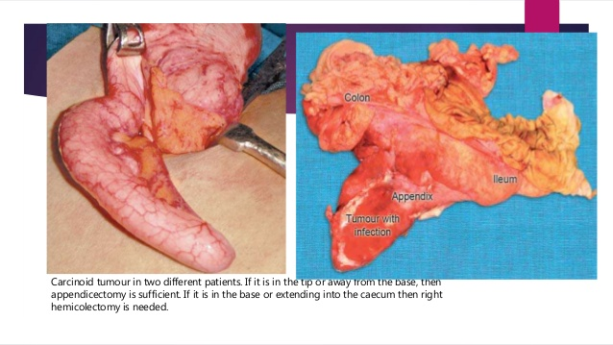
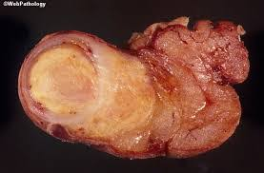

Slide 47
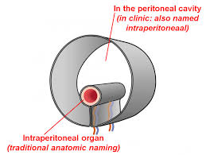
Thank you

Slide 48
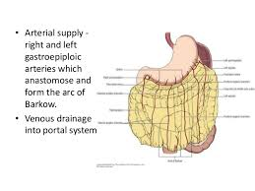
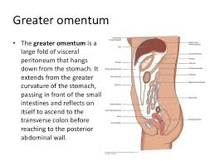

Slide 49
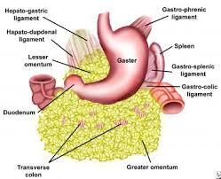
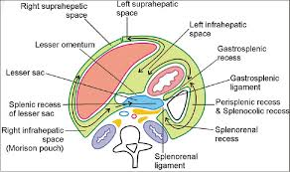

Slide 50
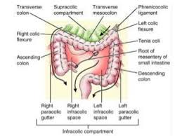
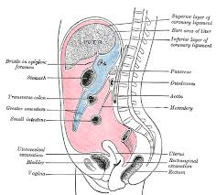

Slide 51
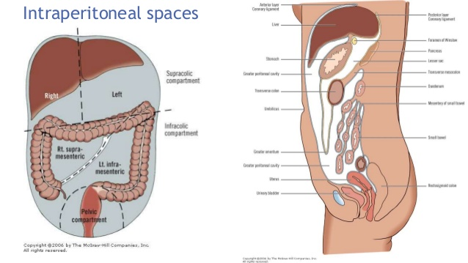

Slide 53
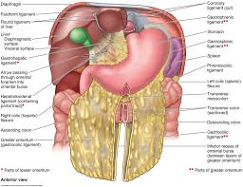
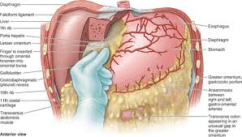
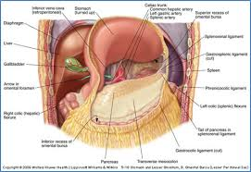

Slide 54
